Slide 1
What Campuses can do to Promote Research Transparency and Data Sharing
SARAH NUSSER, IOWA STATE UNIVERSITY
With contributions from Toby Smith and Emily Miller, AAU, and Kacy Redd, APLU
HELIOS Spotlight Series
August 23, 2022

Slide 2
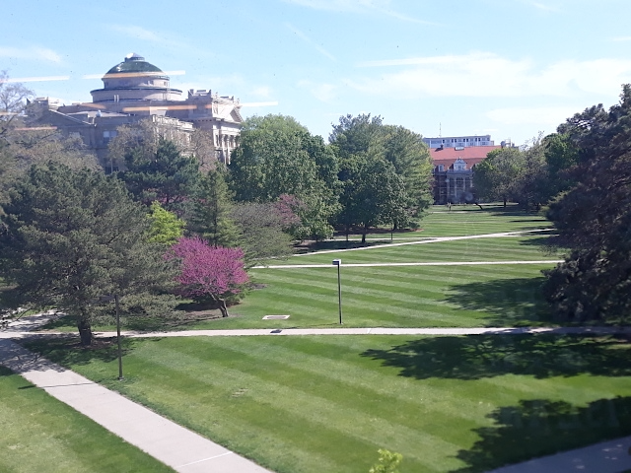
ISU Data Sharing Task Force
Early days (2016)
Collaboration among VPR, Library, CIO
Diverse DSTF membership from faculty and cross-campus offices for research services and compliance

Slide 3
ISU Data Sharing Task Force
Frame: Embrace open science and research transparency (Royal Society 2012, Holdren Memo 2013)
Charge: Actions and guidance needed to support researchers and the institution in providing appropriate public access to research data

Slide 4
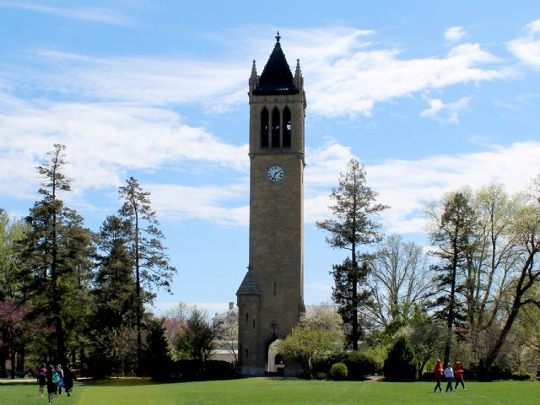
Achievements
Piloted system components
Draft research data policy, repository policy
Prototype data sharing repository service (DataShare)
Cross-office data submission & review workflow prior to deposit
All now fully implemented

Slide 5
A couple of stumbling blocks
Awareness-level support, but lack of advocacy by provost or president
No extra resources planned, including enough time for team members to make timely progress
Discovered but didn’t address other units that may be useful in implementing new practices

Slide 6
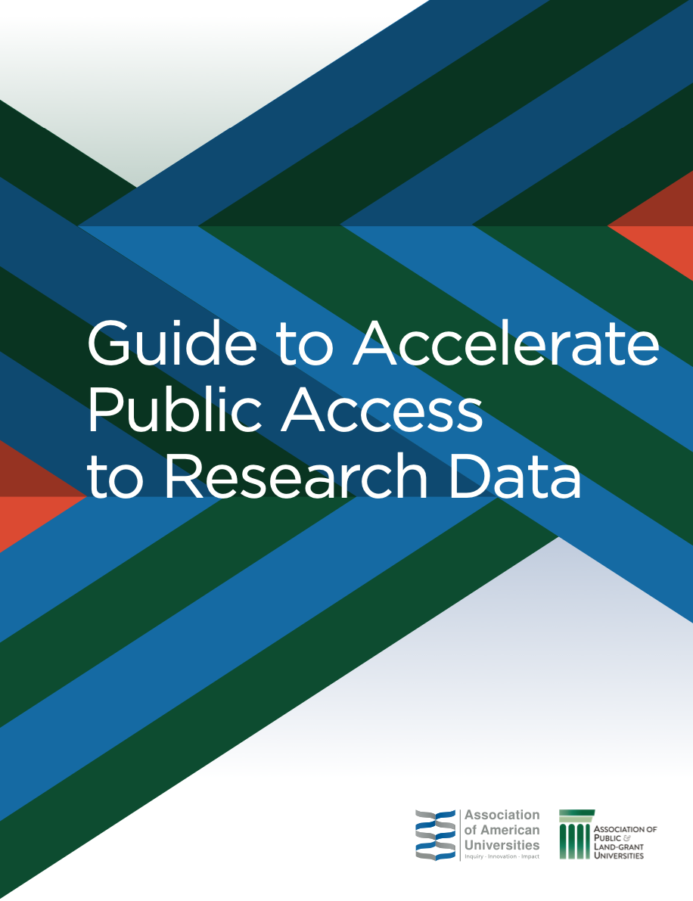
AAU-APLU Guide for Campuses
Resource for campus administrators to accelerate progress
Explains how making research data publicly accessible aligns with campus research mission
Outlines major steps in developing campus data sharing support system
National Science Foundation (Award 1939279), additional support from the National Institute of Health.

Slide 7
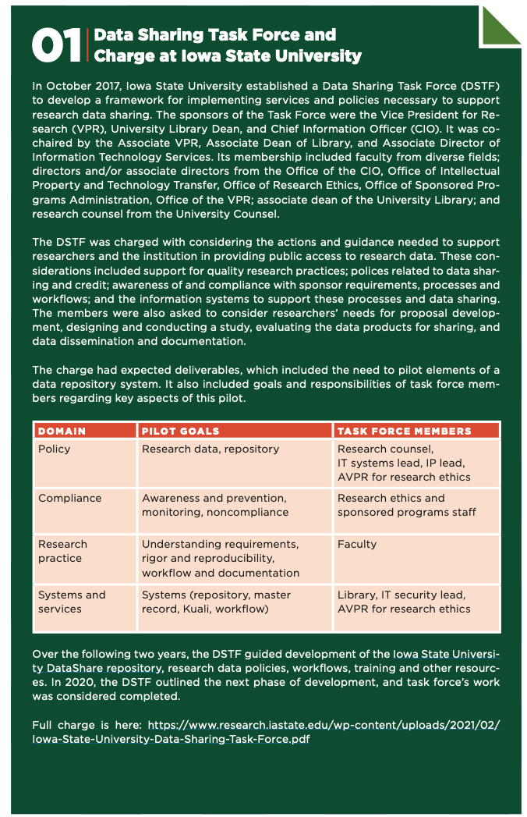
Setting priorities
Senior leadership makes public access to research data a visible priority
Establish a structure for envisioning, planning for and implementing a supporting infrastructure
Notes:
SN

Slide 8
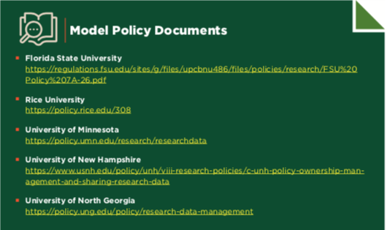
Making a plan
Revisit your campus research policy and compliance workflow
Identify services, expertise and technical needs for data sharing support infrastructure
Estimate costs and resources for implementation plan
Notes:
KR

Slide 9
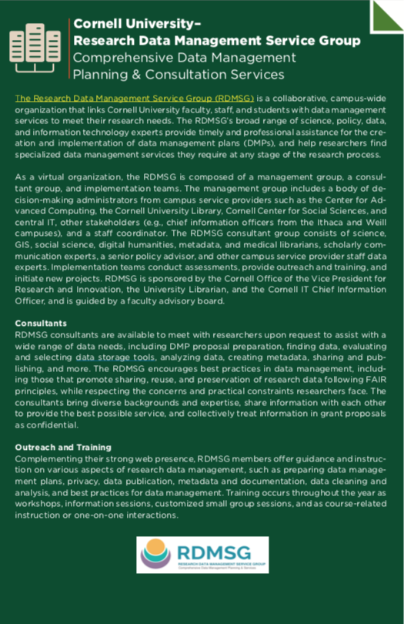
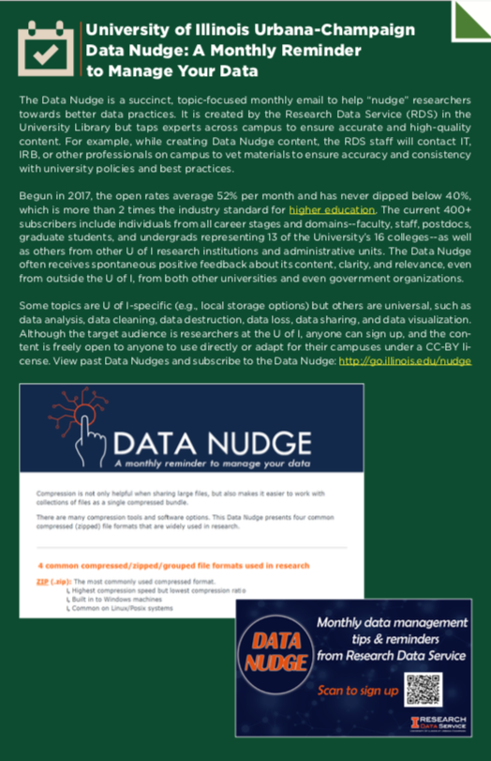
Supporting researchers
Build capacity and skills for good research data services
Develop communications and awareness campaign
Notes:
KR

Slide 10
Opportunities today
Setting up campus policies & systems is the foundation for the hard stuff
Changing research practice (reducing burden with planning and tools)
Changing reward system (consider departmental policies, connect with disciplinary efforts)

Slide 11
Thank you!
AAU-APLU Accelerating Public Access to Research Data
https://www.aau.edu/accelerating-public-access-research-data
ISU DataShare
https://instr.iastate.libguides.com/datashare
ISU Data Sharing Task Force Charge
https://www.research.iastate.edu/for-researchers/research-data/iowa-state-university-data-sharing-task-force
Sarah Nusser
Iowa State University
nusser@iastate.edu
Notes:
New names

