Slide 1
Open Source Programs Offices (OSPOs) and Technology Transfer
November 15, 2022
Sayeed Choudhury
Director of Open Source Programs Office (OSPO)

Slide 3
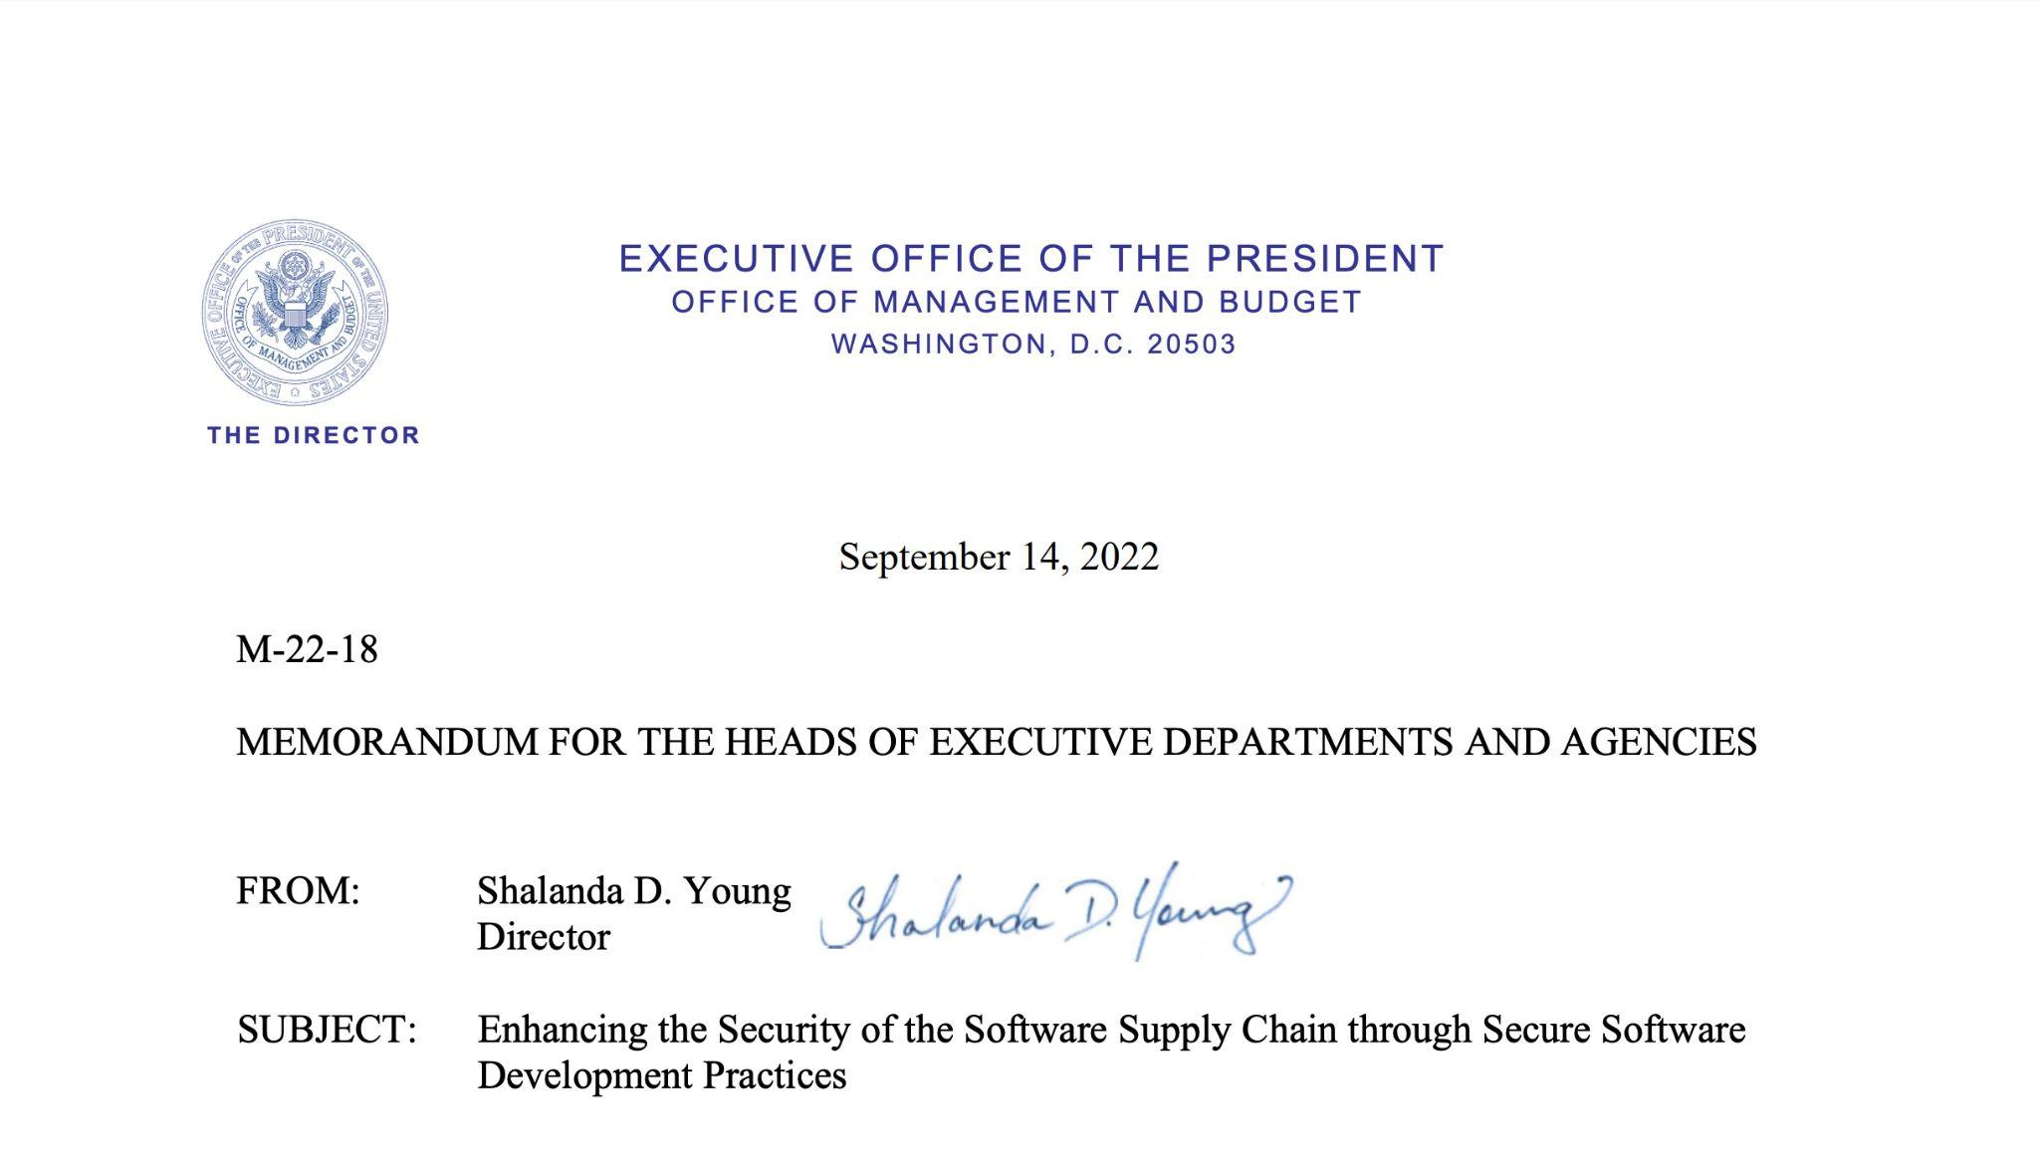

Slide 4
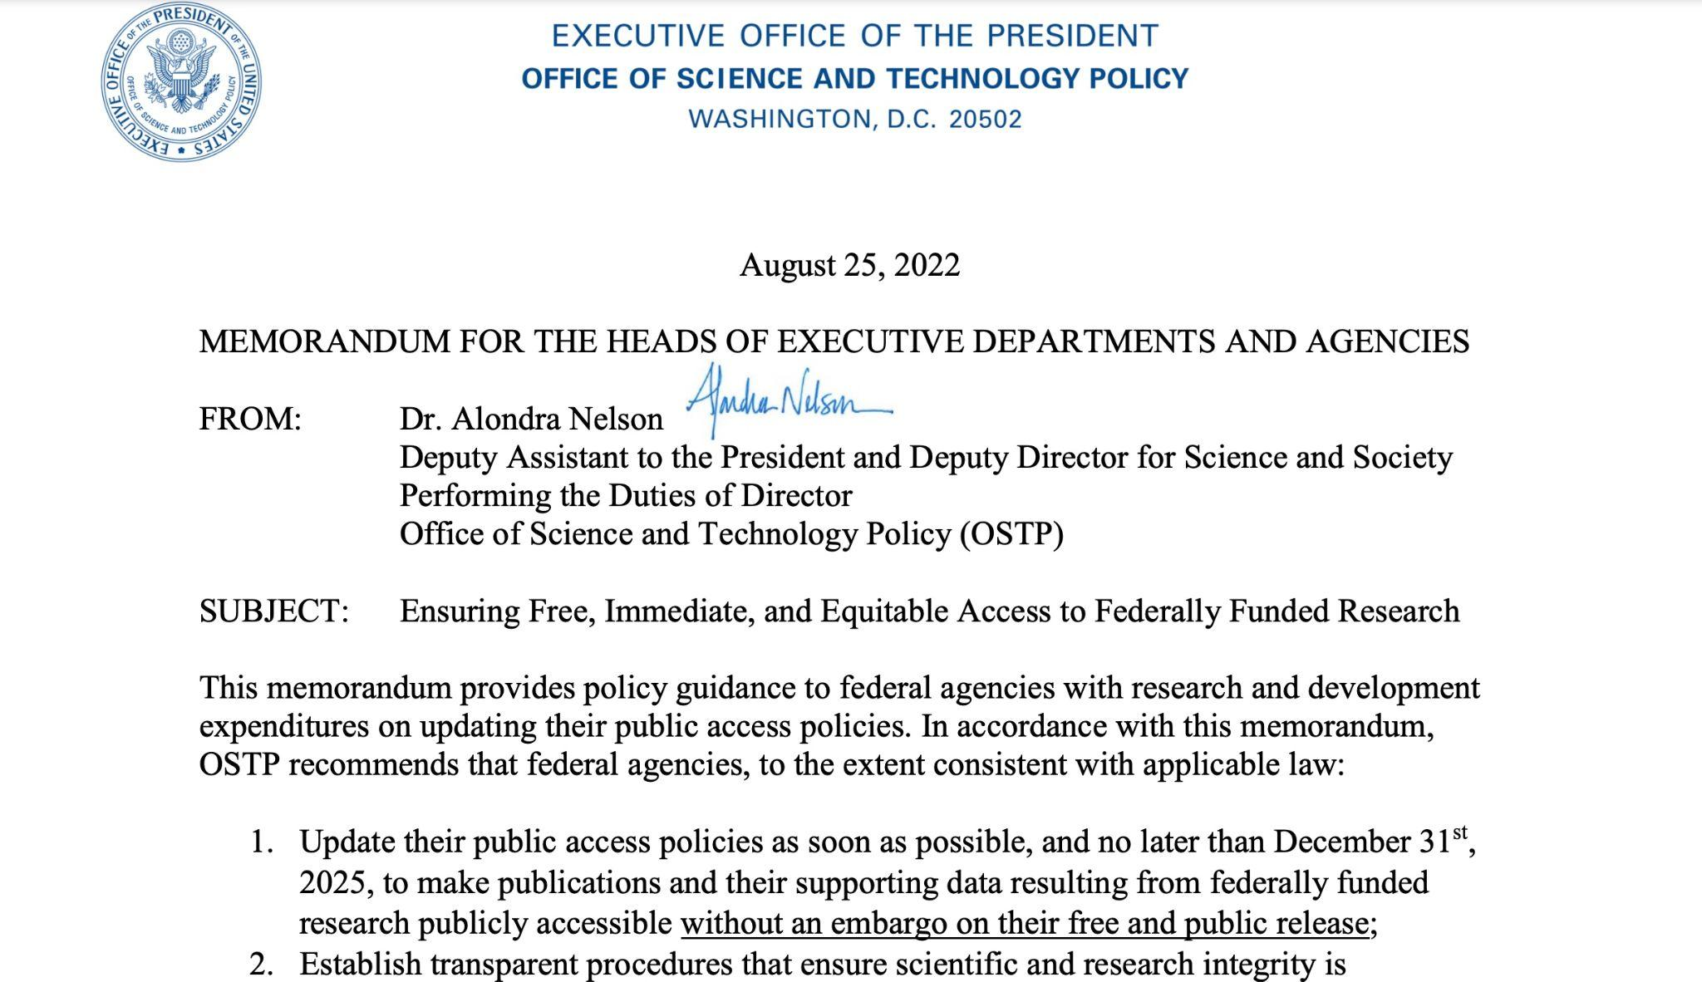

Slide 5
Software as a Primary Research Object – Open Scholarship

Slide 7
OSPOs and Technology Transfer
Opportunity to be pro-active with OSTP with open source software policy
Accomplished through network of OSPOs
Balance between academic freedom, reproducibility, open scholarship – and risk management
Call to action:
Introductory, virtual workshop on OSPOs
Working group focused on open source software and technology transfer, knowledge transfer, and innovation

Slide 8
Questions, Comments, Feedback, Ideas, Discussion

